Slide 1


Know the basics Course # Understand Qualifications and Duties of Poll Watchers # Know how to prepare for Early Voting Ballot Board/ Signature Verification Committee # Understand Provisional Voting
Poll Watching for 2016 General Election
Training Webinar
Hosted By:

Slide 2
Know the basics Course # Understand Qualifications and Duties of Poll Watchers # Know how to prepare for Early Voting Ballot Board/ Signature Verification Committee # Understand Provisional Voting
Poll Watching for 2016 General Election
PLEASE DOWNLOAD THE POLL WATCHERS GUIDE
FROM THE SECRETARY OF STATE WEBSITE AND TAKE THE GUIDE WITH YOU WHILE YOU SERVE.
This class is an overview of the process but you will need to have the guide with you for reference.
Take a notebook or pad to record any discrepancies that you observe as this may be very useful in a subsequent inquiry.
Always be considerate and respectful of the election judge and clerks.

Slide 3
Know the basics Course # Understand Qualifications and Duties of Poll Watchers # Know how to prepare for Early Voting Ballot Board/ Signature Verification Committee # Understand Provisional Voting
Poll Watching for 2016 General Election
Course Objectives
Know the basics of Texas Election Code
Understand qualifications and duties of Poll Watchers
Understand acceptable forms of Voter ID
Understand Provisional Voting

Slide 4
Know the basics Course # Understand Qualifications and Duties of Poll Watchers # Know how to prepare for Early Voting Ballot Board/ Signature Verification Committee # Understand Provisional Voting
Poll Watching for 2016 General Election
Texas Election Code
Texas election Code provides the basics for most situations
The Secretary of State (SOS) periodically issues election advisories on election practices and procedures, available at:
http://www.sos.stste.tx.us/elections/laws/ealaws.shtml
Election Law Opinions & Code are available at:
http://www.sos.stste.tx.us/elections/elo/index.shtml

Slide 5
Know the basics Course # Understand Qualifications and Duties of Poll Watchers # Know how to prepare for Early Voting Ballot Board/ Signature Verification Committee # Understand Provisional Voting
Poll Watching for 2016 General Election
Qualifications & Duties
Be a registered voter of the territory covered by the election and of the county for November General Elections for state and county officers.
NOT be a candidate for public office in an election held on the day the watcher seeks to serve.
NOT hold an elective office.
NOT be an employee of an election judge or clerk serving at the same polling place.
NOT have been finally convicted of an offense in connection with conduct directly attributable to an election.
NOT be related within the second degree of consanguinity or affinity to an election judge or clerk serving at that polling place. A watcher may be related to the candidate the watcher is representing.

Slide 6
Poll Watching for 2016 General Election
Know the basics Course # Understand Qualifications and Duties of Poll Watchers # Know how to prepare for Early Voting Ballot Board/ Signature Verification Committee # Understand Provisional Voting
Qualifications Questions
Q: Does a poll watcher need to live within the election precinct in
which they are serving?
A: NO
Q: Can a person serve as a watcher if they are a candidate?
A: NO
Q: Are elected public officials allowed to serve as watchers?
A: NO
Q: Can officers of a political party serve?
A: YES
Q: Can a candidate’s spouse or child serve as a watcher?
A: YES

Slide 7
Know the basics Course # Understand Qualifications and Duties of Poll Watchers # Know how to prepare for Early Voting Ballot Board/ Signature Verification Committee # Understand Provisional Voting
Poll Watching for 2016 General Election
Appointment of Watcher
BY POLITICAL PARTY
Q: Who appoints a watcher on behalf of political parties?
A: Any three members of the CEC if the Chairman fails to.

Slide 8
Know the basics Course # Understand Qualifications and Duties of Poll Watchers # Know how to prepare for Early Voting Ballot Board/ Signature Verification Committee # Understand Provisional Voting
Poll Watching for 2016 General Election
Appointment of Watcher
BY A CANDIDATE
Q: Who appoints a watcher on behalf of candidates?
A: Watchers may be appointed by any candidate who appears on the ballot. For multi county state office, the campaign treasurer may also appoint.

Slide 9
Know the basics Course # Understand Qualifications and Duties of Poll Watchers # Know how to prepare for Early Voting Ballot Board/ Signature Verification Committee # Understand Provisional Voting
Poll Watching for 2016 General Election
Appointment of Watcher
FOR ELECTIONS ON MEASURES
Q: Who appoints a watcher for elections on measures?
A: The campaign treasurer or assistant treasurer of a specific purpose political action committee that supports or opposes a measure may appoint.

Slide 10
Know the basics Course # Understand Qualifications and Duties of Poll Watchers # Know how to prepare for Early Voting Ballot Board/ Signature Verification Committee # Understand Provisional Voting
Poll Watching for 2016 General Election
Maximum number of watchers
Q: What is the maximum number of watchers that can be
appointed by each appointing authority?
A:1. a maximum of 7 watchers may be appointed for early voting polling places ( no more than 2 on duty at a time).
2. A maximum of 2 watchers per shift may be appointed for each precinct polling place, meeting place for an early voting ballot board, or central counting station involved in the election.

Slide 11
Know the basics Course # Understand Qualifications and Duties of Poll Watchers # Know how to prepare for Early Voting Ballot Board/ Signature Verification Committee # Understand Provisional Voting
Poll Watching for 2016 General Election
ACTIVITIES A POLL WATCHER MAY OBSERVE
Early voting by personal appearance polling place activities, including time before and after polls close. ( If present a poll watcher should sign ballot box seals placed on early voting boxes.)
Election day polling place activities, including time before and after polls close.
Early voting ballot board meeting activities.
Central counting station activities.
Central accumulation activities.
Signature verification committee activities
Voter being assisted by an election official.
Inspecting and securing voting equipment.
Delivery of election results from polling place.

Slide 12
Know the basics Course # Understand Qualifications and Duties of Poll Watchers # Know how to prepare for Early Voting Ballot Board/ Signature Verification Committee # Understand Provisional Voting
Poll Watching for 2016 General Election
Acceptance of Watcher
TIME FOR REPORTING TO THE POLLING PLACES
Q: What time do watchers need to report to the polling places, and how long do they need to stay at the polling place?
A: They may begin service at anytime after the presiding judge arrives and may stay until the election officials complete their duties. They may come and go after 5 hours of consecutive service.
*Bring your voter registration card with you so the
Judge knows you are a resident county voter.

Slide 13
Know the basics Course # Understand Qualifications and Duties of Poll Watchers # Know how to prepare for Early Voting Ballot Board/ Signature Verification Committee # Understand Provisional Voting
Poll Watching for 2016 General Election
Acceptance of Watcher
PRESENTING YOUR CERTIFICATE OF APPOINTMENT
Q: How does one present a certificate of appointment?
You must deliver your certificate to the presiding judge.
You countersign the certificate in the officer’s presence.
A watcher may not be accepted without affidavit.
The judge must keep the certificate in envelope #2.
If the watcher is rejected, the certificate must be returned to the watcher with a signed statement of the reason.

Slide 14
Know the basics Course # Understand Qualifications and Duties of Poll Watchers # Know how to prepare for Early Voting Ballot Board/ Signature Verification Committee # Understand Provisional Voting
Poll Watching for 2016 General Election
POLL WATCHER’S DUTIES
Q: What are a watcher’s duties?
To observe the conduct of the election at the location the watcher has been appointed.
A poll watcher MUST wear a name tag prescribed by the SOS
DO NOT talk to an election officer regarding the election except to call attention to an irregularity or violation
DO NOT converse with a voter
DO NOT converse with other watchers
DO NOT leave during voting hours without presiding judge’s permission unless you have completed 5 consecutive hours of service. The presiding judge may refuse to admit you.

Slide 15
Know the basics Course # Understand Qualifications and Duties of Poll Watchers # Know how to prepare for Early Voting Ballot Board/ Signature Verification Committee # Understand Provisional Voting
Poll Watching for 2016 General Election
POLL WATCHER’S DUTIES
DO NOT REVEAL THE FOLLOWING INFORMATION BEFORE POLLS CLOSE
How a voter has voted ( third degree felony).
The number of votes received for a candidate or measure.
A candidate’s position relative to other candidates in the tabulation of the votes.
Whether a measure is passing or failing.
The names of persons who have or have not voted in the election.

Slide 16
Know the basics Course # Understand Qualifications and Duties of Poll Watchers # Know how to prepare for Early Voting Ballot Board/ Signature Verification Committee # Understand Provisional Voting
Poll Watching for 2016 General Election
WHAT IS A WATCHER PERMITTED TO DO ON DUTY
Permitted but not required:
Witness the installation of voting machines.
Observe securing equipment before the election.
You may leave briefly to use phone without losing continuous hours.
Sit or stand conveniently near election officials to observe activities.
Make written notes while on duty ( do not take with you, if returning).
Observe assistance given to voters by election officials and inspect the ballot before it is deposited in the ballot box to determine it was prepared in accordance with the voter’s wishes.
Inspect the returns & records prepared by the election officers.
Witness securing the voting system equipment.
Receive an English translation between an election official and voter.

Slide 17
Know the basics Course # Understand Qualifications and Duties of Poll Watchers # Know how to prepare for Early Voting Ballot Board/ Signature Verification Committee # Understand Provisional Voting
Poll Watching for 2016 General Election
ILLEGAL ACTIVITIES TO WATCH FOR
The election judge may be notified of any activity
that appears to be prohibited by law
Election workers allowing voters to vote a regular ballot who do not:
1) present a supporting form of ID.
2) present a supporting form of ID and execute a Reasonable Impediment
Declaration.
3) Present a voter registration certificate with an E notation on it.
Electioneering and loitering within 100 ft of the entrance of the building in which a polling place is located. Including the wearing of a badge, insignia, emblem or similar device relating to a candidate or measure.

Slide 18
Know the basics Course # Understand Qualifications and Duties of Poll Watchers # Know how to prepare for Early Voting Ballot Board/ Signature Verification Committee # Understand Provisional Voting
Poll Watching for 2016 General Election
ILLEGAL ACTIVITIES TO WATCH FOR
The election judge may be notified of any activity
that appears to be prohibited by law
Unlawful operation of a sound amplification device
Bribing voters
Tampering with a direct recording electronic machine
Unlawfully influencing voters
Coercing voters
Unlawfully revealing how a voter voted
Voting illegally
Unlawfully accepting or refusing to accept voters
Using a wireless communication device within 100 ft of polling place
Interfering with voting process

Slide 19
Know the basics Course # Understand Qualifications and Duties of Poll Watchers # Know how to prepare for Early Voting Ballot Board/ Signature Verification Committee # Understand Provisional Voting
Poll Watching for 2016 General Election
PERSONS ALLOWED IN THE POLLING PLACES
Election Judge & Clerks
Poll watchers and SOS inspectors
Persons admitted to vote
Children under 18 who are with a voting parent
Persons providing assistance for an entitled voter
Federal Inspectors appointed by U.S. DOJ
Persons summoned by presiding judge to act as special peace officer to preserve order
Voting systems technician by request

Slide 20

Providing Identification for Voting in Texas
Effective for all elections with voting beginning on or after August 10, 2016, including the November 8, 2016 general election, until further notice.

Slide 21
Updated Procedure
The voter should be asked whether the voter possesses one of the acceptable forms of photo ID on “List A” that is either current or not expired more than four years.
If the voter says “yes”, the voter is required to present that form of photo ID.
NOTE: If a voter has continued access to their acceptable form of photo ID, but, for example, forgets to bring their acceptable form of photo ID to the polling place and/or left it, for example, at home or in their car, the voter still possesses the acceptable photo ID and must use it to vote. Accordingly, if the voter states that the voter possesses, but did not bring to the polling place, an acceptable form of photo ID, the voter may vote a provisional ballot and bring the acceptable form of photo ID to the county within 6 days to cure their ballot (or return to the polling place with the acceptable form of photo ID before the polls close on Election Day and vote then).
If the voter says “no”, ask the voter whether the voter cannot reasonably obtain an acceptable form of photo ID on List A. If the voter indicates “yes”, you must inform the voter that he or she can present a supporting form of ID on “List B” and complete a “Reasonable Impediment Declaration.” If the voter presents a supporting form of ID and completes the Declaration, the voter will then complete their check-in, and proceed to the voting booth to cast a regular ballot. If this voter did not bring a supporting form of ID to the polling place, the voter may vote a provisional ballot and bring an acceptable form of photo ID to the county within 6 days to cure their ballot (or return to the polling place with their supporting form of ID before the polls close, and execute a Reasonable Impediment Declaration and vote then).

Slide 22
Addresses
You should not compare the address on any ID (List A or List B) to the address on the list of registered voters.
  THEY ARE NOT REQUIRED TO MATCH!!!
You are only required to confirm with the voter that the address on the list of registered voters is correct. (§63.0011)
  For example, by asking the voter: “Do you still live on Main Street?”
  This allows the voter to update their registration records.

Slide 23
If the voter says…
Yes: This confirms that their registration records are up-to-date, the voter should:
  Complete the check-in process once the voter has shown a List A ID or if the voter qualifies, has shown a List B ID and completed the Declaration, and proceed to voting a regular ballot.

Slide 24
If the voter says…
No: This means that the voter needs to update their address with the voter registrar, the voter should:
    Complete a Statement of Residence.
    Complete the check-in process once the voter has shown a List A ID or, if the voter qualifies, has shown a List B ID and completed the Declaration, and proceed to voting a regular ballot.

Slide 25
“List A” – Acceptable Forms of ID
  There are 7 forms of ID on List A:
  Texas driver license issued by the Texas Department of Public Safety (DPS);
  Texas personal identification card issued by DPS;
  Texas Election Identification Certificate issued by DPS;
  Texas handgun license issued by DPS;
  United States military identification card containing the person’s photograph;
  United States citizenship certificate containing the person’s photograph;
  United States passport.

Slide 26
Expiration Dates
Updated Procedure: An acceptable identification from “List A” must not have expired more than 4 years before being presented at the polling place.
  This is different than some previous elections where the expiration date was required to be not more than 60 days.

Slide 27
Expiration Dates
Remember – some ID cards do not expire, including:
  Texas Identification Cards for persons aged 60 or older may be permanent and marked “INDEF.”
  Texas Election Identification Certificates (EIC) for persons aged 70 or older are permanent cards.
  Some military ID cards are permanent, including Uniformed Services ID cards and Veterans Affairs ID cards. These are usually marked “INDEF.”
  Certificates of Naturalization and Certificates of Citizenship do not expire.

Slide 28
List B – Supporting Forms of ID
If the voter does not possess an ID from List A, and the voter cannot obtain an ID from List A due to a reasonable impediment, they may present one of the following forms of ID and execute the “Reasonable Impediment Declaration”:
  valid voter registration certificate;
  certified birth certificate;
  copy of or original current utility bill;
  copy of or original bank statement;
  copy of or original government check;
  copy of or original paycheck; or
  copy of or original of other government document with voter’s name and an address (original required if it contains a photograph)

Slide 29
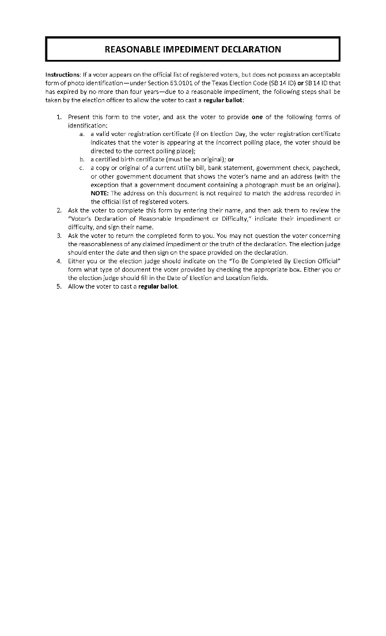
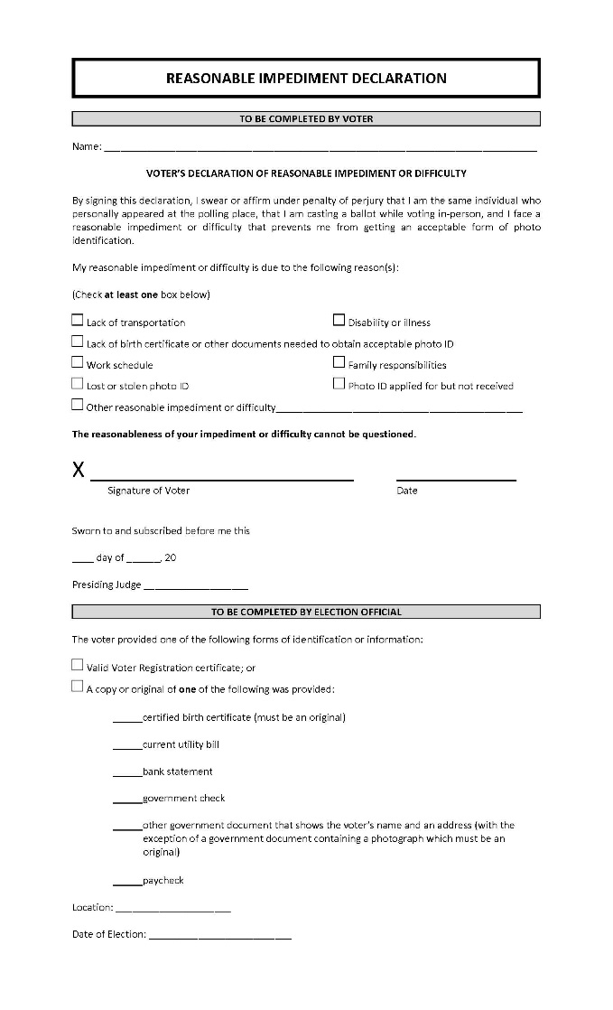
Reasonable Impediment Declaration

Slide 30
Reasonable Impediment Declaration
The voter must indicate one of the following impediments:
  Lack of transportation
  Disability or illness
  Lack of birth certificate or other documents needed to obtain photo ID
  Work schedule
  Family responsibilities
  Lost or stolen photo ID
  Photo ID applied for but not received
  Other reasonable impediment (the voter must provide a description)

Slide 31
Declaration of Reasonable Impediment
You may not question or challenge the voter regarding their lack of, and their being reasonably unable to obtain, List A ID.
  If the voter states that they do not possess an acceptable ID from “List A,” and the voter, in response to your question as to whether they cannot reasonably obtain an acceptable ID from “List A”, answers “yes,” that they cannot reasonably obtain an acceptable ID from “List A”, you must explain their right to complete the Reasonable Impediment Declaration and show a supporting form ID from “List B.”
You may not question the reasonableness of the voter’s reasonable impediment or the truth of the declaration.
  For example, if the voter checks “lack of transportation”, you may not challenge the voter’s access to a bus route or other means of transportation.
A signed reasonable impediment declaration shall be rejected only upon conclusive evidence that the person completing the declaration is not the person in whose name the ballot is cast.

Slide 32
List A – Acceptable Forms of ID

Slide 33
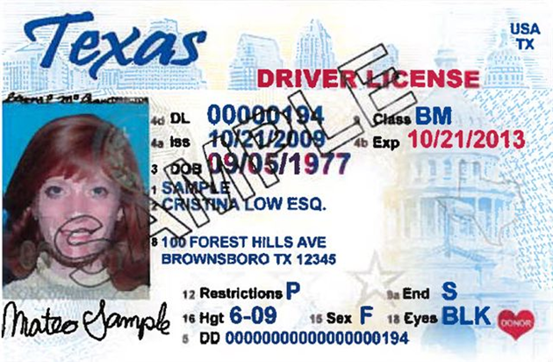
Texas Driver’s License
Photograph: This ID must contain a photograph of the voter.
Expiration Date: Must be valid, or expired within 4 years.
Name: If the voter’s name on list of registered voters in the precinct, does not match exactly to the ID provided, a “Substantially Similar Name Affidavit” must be completed by the voter.
NOTE: This form of ID should not be used if “Limited Term” or “Temporary Visitor” appears on the face of the card as this indicates the person is not a U.S. Citizen.
10/19/2016
33

Slide 34



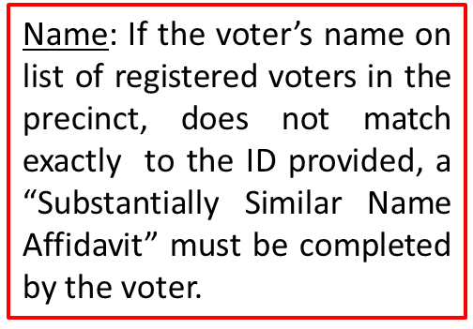
Texas Driver’s License – Under 21
Photograph: This ID must contain a photograph of the voter.
Expiration Date: Must be valid, or expired within 4 years.
NOTE: This form of ID should not be used if “Limited Term” or “Temporary Visitor” appears on the face of the card as this indicates the person is not a U.S. Citizen.

Slide 35
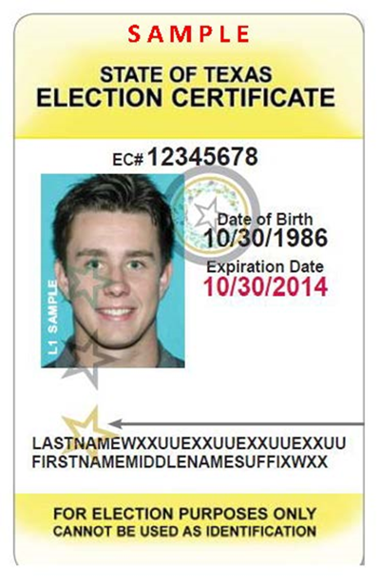
Election Identification Certificate (EIC)
Photograph: This ID must contain a photograph of the voter.
Expiration Date: Must be valid, or expired within 4 years. EICs do not expire for persons age 70 or older.
Name: If the voter’s name on list of registered voters in the precinct, does not match exactly to the ID provided, a “Substantially Similar Name Affidavit” must be completed by the voter.

Slide 36
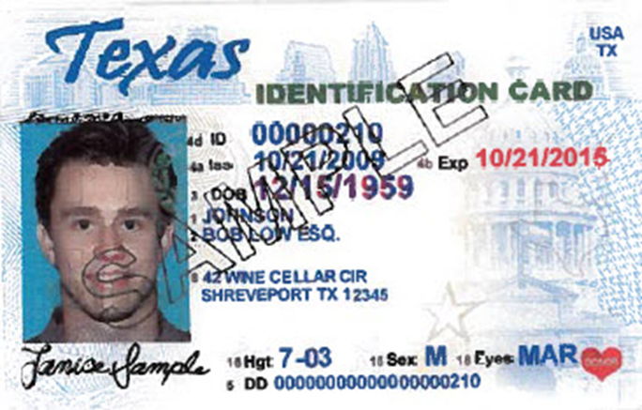
Texas Personal Identification Card
Photograph: This ID must contain a photograph of the voter.
Expiration Date: Must be valid, or expired within 4 years. NOTE: Some Personal ID Cards may not expire.
Name: If the voter’s name on list of registered voters in the precinct, does not match exactly to the ID provided, a “Substantially Similar Name Affidavit” must be completed by the voter.
NOTE: This form of ID should not be used if “Limited Term” or “Temporary Visitor” appears on the face of the card as this indicates the person is not a U.S. Citizen.

Slide 37
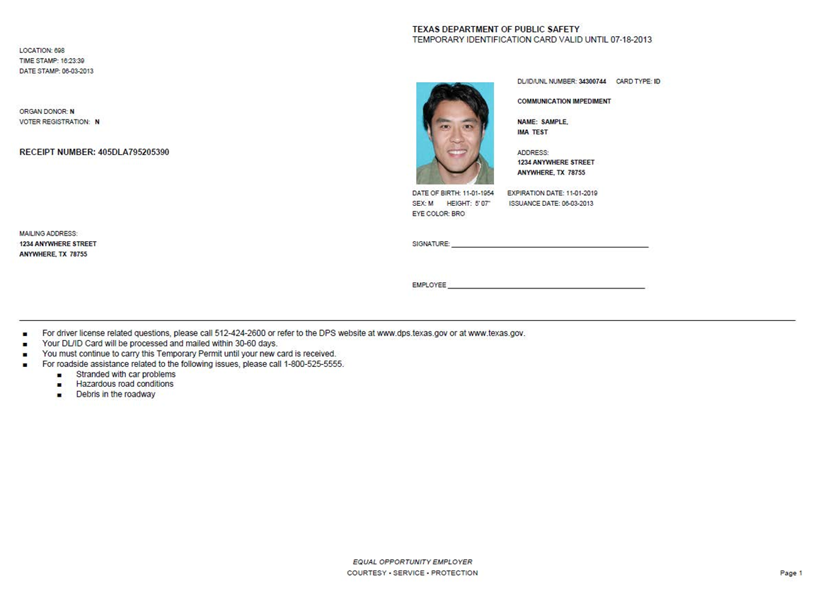
DPS Receipts with Photo

Slide 38
DPS Receipts with Photo
Receipts are issued at DPS locations when you apply for a driver’s license, identification card, or EIC.
They are printed on letter sized paper.
They are used until real card is received by individual in the mail.
The receipt should not be expired more than 4 years before being presented for voting.

Slide 39
Handgun License
Photograph: This ID must contain a photograph of the voter.
Expiration Date: Must be valid, or expired within 4 years.
Name: If the voter’s name on list of registered voters in the precinct, does not match exactly to the ID provided, a “Substantially Similar Name Affidavit” must be completed by the voter.

Slide 40
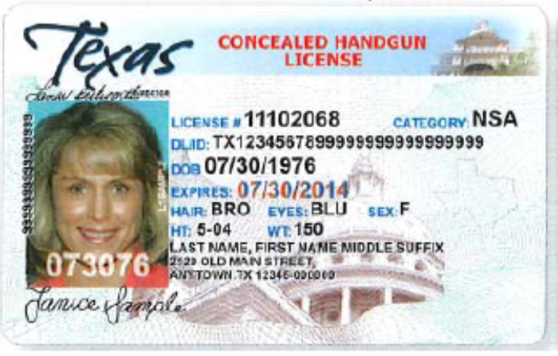
Concealed Handgun License
This version of the CHL was issued through April 2014 and they are valid for 4-5 years.
This version of the CHL was issued through August 2015 and they are valid for 4-5 years.

Slide 41
U.S. Military Identification Cards
The following standards should be used by poll workers to determine if a United States military card is acceptable:
  The ID card is federal;
  The ID card is military;
  The ID card contains a photograph;
  The ID contains an expiration date which is in the future or is the date of presentation, or a past expiration date which was not more than 4 years from the date of presentation, or the ID does not contain any expiration date.

Slide 42
U.S. Military Identification Cards
Military ID Cards may include, but are not necessarily limited to:
Department of Defense (DoD) Common Access Card (CAC)
Uniformed Services ID Cards
DoD Civilian Retiree Cards
Veterans Affairs ID Cards

Slide 43
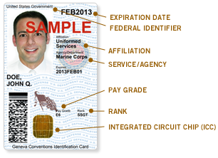

DoD Common Access Card “CAC”
  NOTE: The seals to the right of the picture will change according to branch of service.

Slide 44
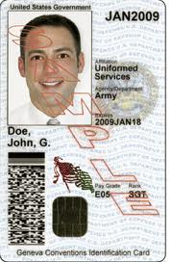
Voting in Texas with a CAC
Photograph: This ID must contain a photograph of the voter.
Expiration Date: Must be valid, or expired within 4 years.
Name: If the voter’s name appears on the list of registered voters in the precinct, but does not match exactly to the ID provided, a “Substantially Similar Name Affidavit” must be completed by the voter.

Slide 45


Exception
CACs with a blue bar across the name signify that the cardholder is a non-U.S. citizen, and may not be a qualified voter.
Contractors will have a green bar, which will be sufficient for use if other qualifications are met.

Slide 46
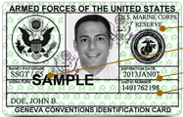
Uniformed Services ID Cards
There are four versions of Uniformed Services ID Cards. All look similar, but are issued in four different colors.

Slide 47
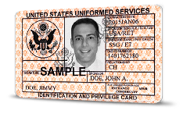
Voting in Texas with Uniformed Services ID Cards
Photograph: This ID must contain a photograph of the voter.
Expiration Date: Must be valid, or expired within 4 years. However, not all cards expire-some will say “INDEF” for indefinitely.
Name: If the voter’s name appears on the list of registered voters in the precinct, but does not match exactly to the ID provided, a “Substantially Similar Name Affidavit” must be completed by the voter.

Slide 48




Uniformed Services ID Cards
Green – Generally for members of the Individual Ready Reserves and Inactive National Guard.
Blue – Generally for retirees, and members on Disability Retired Lists.
Pink – Generally for retired members of the Reserves and National Guard under the age of 60, and certain dependents.
Orange – Generally for certain dependents (active duty), Medal of Honor recipients, disabled veterans, and others.

Slide 49
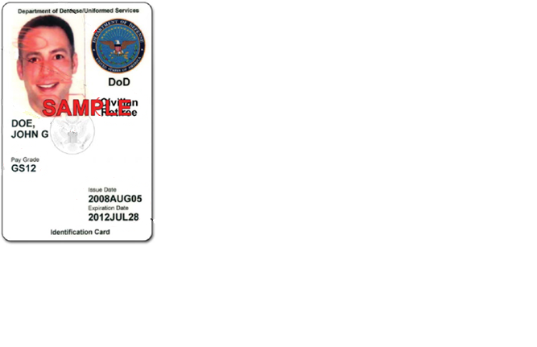
DoD Civilian Retiree Cards
Photograph: This ID must contain a photograph of the voter.
Name: If the voter’s name appears on the list of registered voters in the precinct, but does not match exactly to the ID provided, a “Substantially Similar Name Affidavit” must be completed by the voter.
Expiration Date: Must be valid, or expired within 4 years.

Slide 50
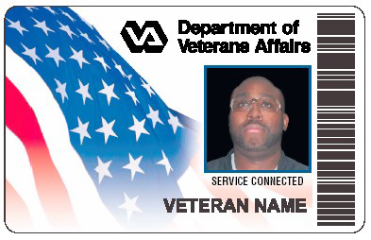
Veteran Identification Card (VIC)
Photograph: This ID must contain a photograph of the voter.
Name: If the voter’s name appears on the list of registered voters in the precinct, but does not match exactly to the ID provided, a “Substantially Similar Name Affidavit” must be completed by the voter.
Veteran Affairs IDs do not expire.

Slide 51
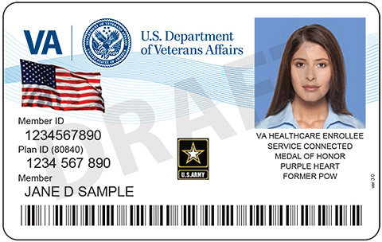
Veteran Health Identification Card (VHIC)
Photograph: This ID must contain a photograph of the voter.
Name: If the voter’s name appears on the list of registered voters in the precinct, but does not match exactly to the ID provided, a “Substantially Similar Name Affidavit” must be completed by the voter.
VHICs may or may not have an expiration date.

Slide 52
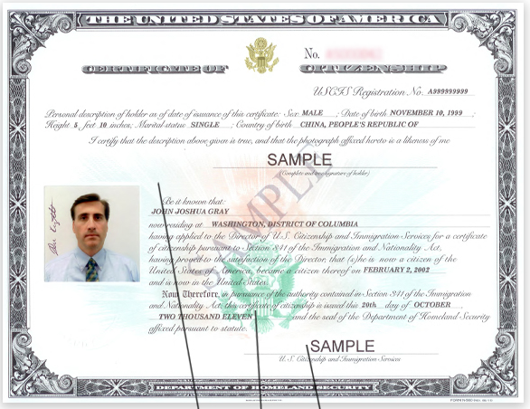
U.S. Certificate of Citizenship
REMEMBER – Certificates of Citizenship do not expire.

Slide 53
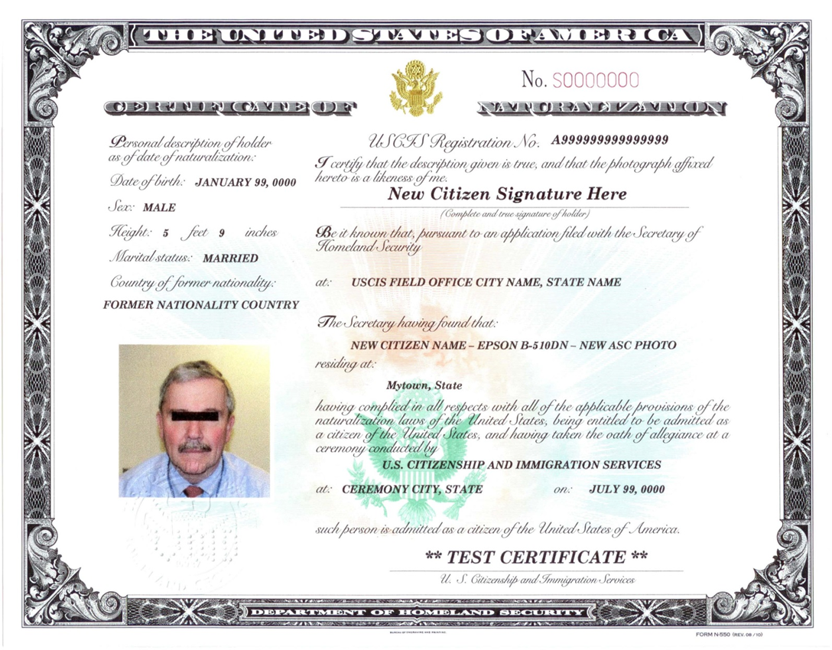
U.S. Certificate of Naturalization
REMEMBER – Certificates of Naturalization do not expire.

Slide 54
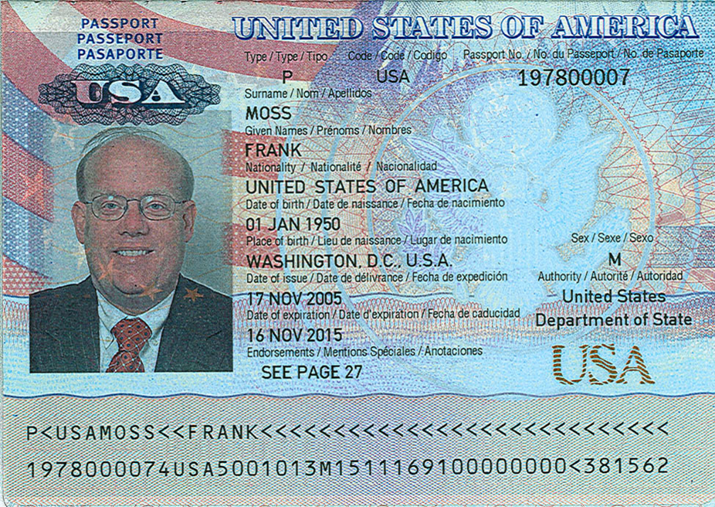
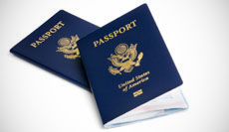
U.S. Passport

Slide 55
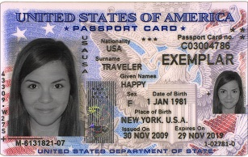
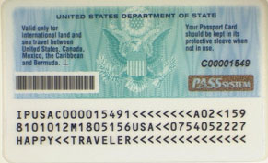
U.S. Passport Card
Allows entry from Canada, Mexico, the Caribbean, and Bermuda at land border crossings or sea ports-of-entry.
Wallet Size.
Front
Back

Slide 56
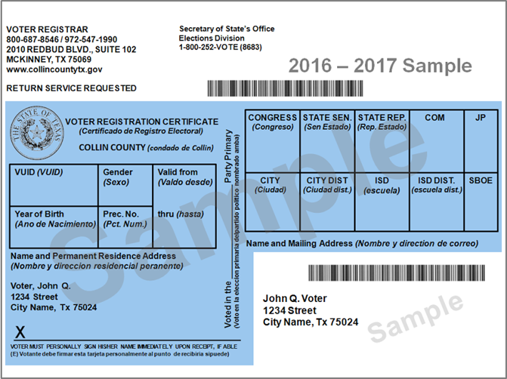
Permanent Exemption
If a voter has applied for and received a permanent exemption to the photo ID requirement, they will provide a voter registration certificate with an (E) notation.
NOTE: Designation of (E) next to VUID Number.
Example: 1197099876 (E).

Slide 57
Permanent Exemption
If the voter has a permanent exemption, and they present their voter registration certificate with the (E) next to the VUID, they do not need to also complete a Reasonable Impediment Declaration.

Slide 58
List B – Supporting Forms of ID

Slide 59
Valid Voter Registration Certificate

Slide 60
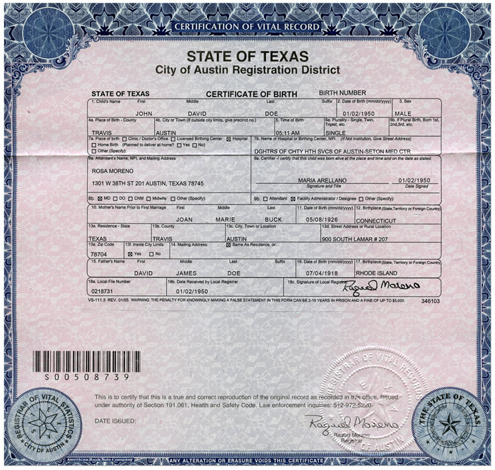
Certified Birth Certificate (Must Be An Original)
It may be from another state or country-does not have to be from Texas.
It must not be a copy of a certified copy.
If the voter’s name appears on the list of registered voters in the precinct, but does not match exactly to the ID provided, a “Substantially Similar Name Affidavit” must be completed by the voter.

Slide 61
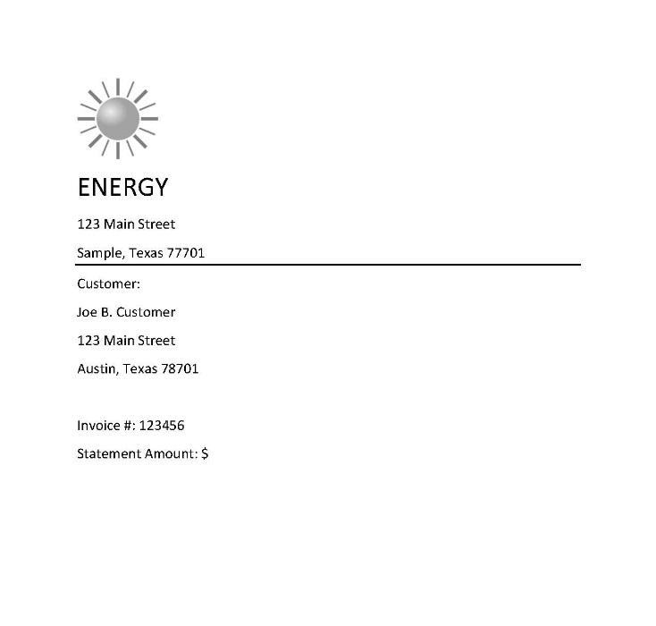
Copy of or Original Current Utility Bill
It may be a copy or printout.
To be current, the utility bill must be the most recent version or at least dated within two (2) months of the date it is presented to an election official.
The address on the utility bill does not have to match the address on the list of registered voters. However, per §63.0011, the voter should be asked if the address on the list of registered voters is current. For example, “Do you still live on Main Street?”
If the voter’s name appears on the list of registered voters in the precinct, but does not match exactly to the ID provided, a “Substantially Similar Name Affidavit” must be completed by the voter.

Slide 62
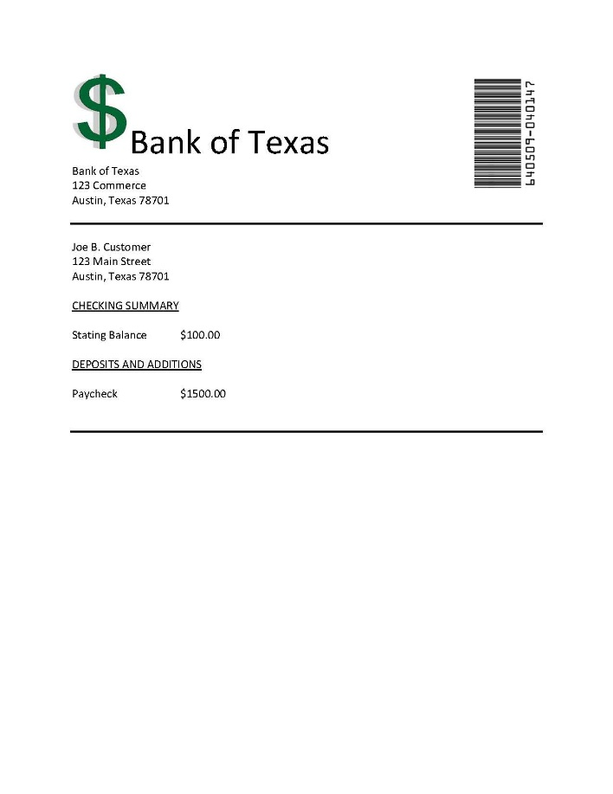
Copy of or Original Bank Statement
It may be a copy or printout.
The address on the bank statement does not have to match the address on the list of registered voters. However, per §63.0011, the voter should be asked if the address on the list of registered voters is current. For example, “Do you still live on Main Street?”
If the voter’s name appears on the list of registered voters in the precinct, but does not match exactly to the ID provided, a “Substantially Similar Name Affidavit” must be completed by the voter.

Slide 63
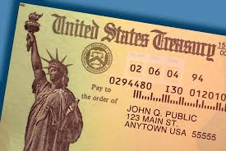
Copy of or Original Government Check
It may be an original check or a copy of the check.
The address on the government check does not have to match the address on the list of registered voters. However, per §63.0011, the voter should be asked if the address on the list of registered voters is current. For example, “Do you still live on Main Street?”
If the voter’s name appears on the list of registered voters in the precinct, but does not match exactly to the ID provided, a “Substantially Similar Name Affidavit” must be completed by the voter.

Slide 64
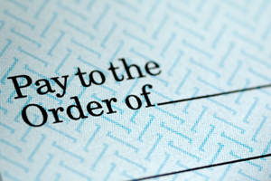
Copy of or Original Paycheck
It may be a copy or original of the check.
The address on the paycheck does not have to match the address on the list of registered voters. However, per §63.0011, the voter should be asked if the address on the list of registered voters is current. For example, “Do you still live on Main Street?”
If the voter’s name appears on the list of registered voters in the precinct, but does not match exactly to the ID provided, a “Substantially Similar Name Affidavit” must be completed by the voter.

Slide 65
Copy of or Original of Other Government Document
MUST include voter’s name and an address. REMEMBER: The address on the supporting ID does not have to match the voter’s registration address.
It must be an original document if it contains a photograph.
If the voter’s name appears on the list of registered voters in the precinct, but does not match exactly to the ID provided, a “Substantially Similar Name Affidavit” must be completed by the voter.
Must be issued by the federal government, a federally recognized tribal government, or a state or local government in the U.S.

Slide 66
Other Government Documents
Examples of Other Government Documents:
  Driver’s licenses from other states
  ID cards issued by federally recognized Native American tribes (if the ID card contains an address)
  DPS Receipts (without a photo)
  Expired voter registration certificates
  Expired Texas DPS-issued driver licenses or personal ID cards (over 4 years).

Slide 67
Other Government Document
Examples of Documents NOT included:
  Social Security Cards (no address)
  State College IDs (if no address)
  State/Federal Employee ID Cards (if no address)
  Library Cards (if no address)

Slide 68
Know the basics Course # Understand Qualifications and Duties of Poll Watchers # Know how to prepare for Early Voting Ballot Board/ Signature Verification Committee # Understand Provisional Voting
Poll Watching for 2016 General Election
Who do you report a discrepancy or irregular voting to?
You may point out a problem to a clerk, who may refer you to the judge, if so you are not allowed to approach the same clerk again for that matter.
You may call your County Elections Administrator, so have their number available.
You may also call the Elections office of the Secretary of State at 512 463 5650.
Record all matters in your notebook for reference.

Slide 69
http://www.sos.state.tx.us/elections/forms/election_judges_handbook.pdf
Know the basics Course # Understand Qualifications and Duties of Poll Watchers # Know how to prepare for Early Voting Ballot Board/ Signature Verification Committee # Understand Provisional Voting
Poll Watching for 2016 General Election
For further information go to the Secretary of State
Website to download and study the Judge and Clerk handbook
http://sos.state.tx.us/elections/forms/election_judges_handbook.pdf
Thank you for serving !

