Slide 1
CANDIDATE RESOURCE COMMITTEE CAPITAL CLUB
Platinum Level Member
SENATOR JANE NELSON SD 12
Senate Finance Committee Chairwoman
Longtime CRC Supporter

Slide 2
CANDIDATE RESOURCE COMMITTEE CAPITAL CLUB
Platinum Level Member
SENATOR Kelly Hancock SD 9
Senate Administrative Chairman
Senator Business and Commerce Chairman

Slide 3
CANDIDATE RESOURCE COMMITTEE CAPITAL CLUB
Platinum Level Member
SENATOR
PAUL BETTENCOURT SD 7
Senate GOP Caucus Chairman
Former CRC Committee member
Property Tax Reform Warrior

Slide 4
CANDIDATE RESOURCE COMMITTEE CAPITAL CLUB
Platinum Level Member
Congressman Kevin Brady HD 8
Chairman of the House Ways and Means Committee
Thank you CRC Committee member Bob Borokoft

Slide 5
CANDIDATE RESOURCE COMMITTEE CAPITAL CLUB
Platinum Level Member
Rep. Todd Hunter HD 8
Chairman of the Calendar Committee
Thank you CRC Committee member Janie Melendez

Slide 6
CANDIDATE RESOURCE COMMITTEE CAPITAL CLUB
Platinum Level Member
GOP CONGRESSIONAL NOMINEE HD 6
TARRANT CO TAX ASSESSOR-COLLECTOR
RON WRIGHT
Future Freedom Caucus Member
Former CRC FUND RECIPIENT

Slide 7
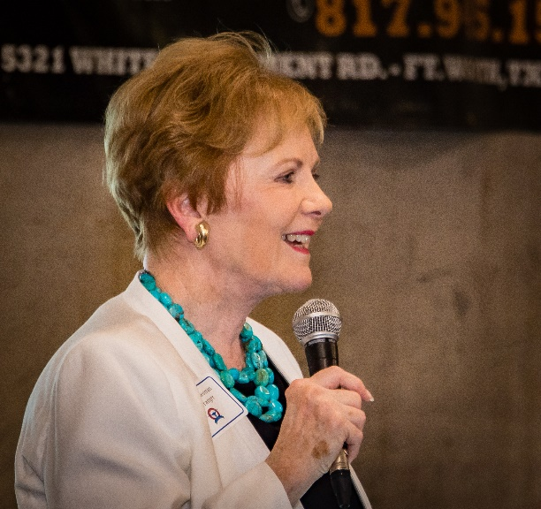
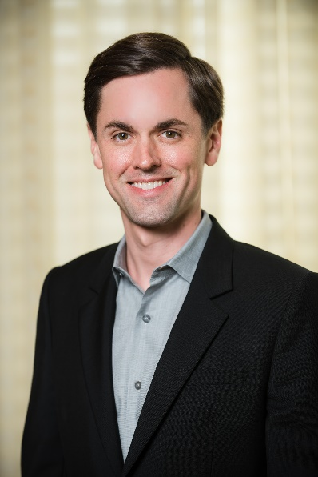
CANDIDATE RESOURCE COMMITTEE CAPITAL CLUB
Gold Level Members
Hon. Kay Granger
Congresswoman TX HD 12
Mayes Middleton
Republican Nominee in HD 23

Slide 8
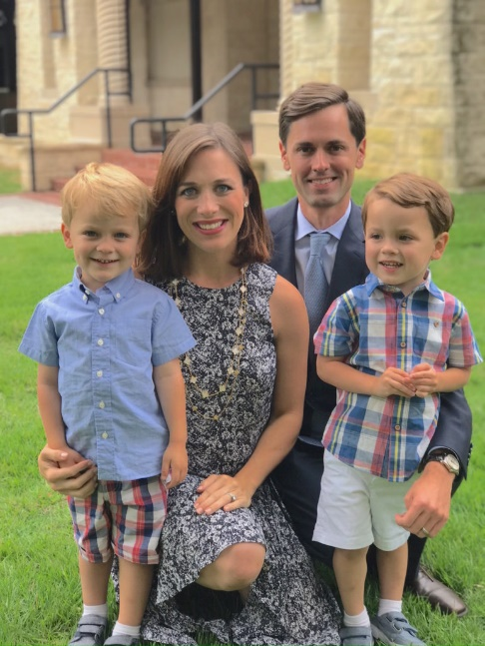
CANDIDATE RESOURCE COMMITTEE CAPITAL CLUB
Gold Level Member
Mayes Middleton

Slide 9
CANDIDATE RESOURCE COMMITTEE CAPITAL CLUB
Silver Level Members
State Representative Phil King HD 61
State Representative Jason Isaac HD 45
State Representative Gio Capriglione HD 98
Tarrant County Judge Glen Whitley
Former SREC SD 12 Mona Bailey
CRC Committee member Cindy Asche

Slide 10
CANDIDATE RESOURCE COMMITTEE CAPITAL CLUB
Bronze Level Member
Texas Ag. Commissioner Sid Miller
Texas Land Commissioner George P. Bush
Texas Railroad Commissioner Christi Craddick
Texas Railroad Commissioner Ryan Sitton
US Congressman CD 13 Mac Thornberry
US Congressman CD 26 Dr. Michael Burgess
US Congressman CD 25 Roger Williams
US Congressman CD 24 Kenny Marchant
State Senator SD 1 Brian Hughes

Slide 11
CANDIDATE RESOURCE COMMITTEE CAPITAL CLUB
Bronze Level Member
State Representative HD 96 Bill Zedler
State Representative HD 93 Matt Krause
State Representative HD 91 Stephanie Klick
State Representative HD 92 Jonathan Stickland
State Representative HD 96 Craig Goldman
State Representative HD 5 Cole Hefner
State Representative HD 68 Drew Springer
State Representative HD 11 Travis Clardy
Mayor Dalworthington Gardens Kimberly Fitzpatrick
Republican Party Chairman James Dickey
National Committeewoman Toni Anne Dashiell

Slide 12
CANDIDATE RESOURCE COMMITTEE CAPITAL CLUB
Bronze Level Member
SREC Sgt-at-arms Nelda Eppes
SREC Committeewoman Marian Stanko
State Rep Candidate & SREC Committeewoman Candy Nobel
SREC Committeewoman Melanie Flowers
Fmr. SREC Committeewoman Rena Peden
Nueces County Chair Mike Bergsma
Fmr SREC Parlimentarian Richard Hayes
Melody Gillett
Republican Club of Bexar Co
Bastrop County GOP

Slide 13
CANDIDATE RESOURCE COMMITTEE CAPITAL CLUB
Copper Level Member
Republican Women of Northeast Texas
Titus County Republican Party
Republican Women of Greater North Texas

