Slide 1

THE CANDIDATE RESOURCE COMMITTEE

Slide 2

THE ANSWER ……………
CRC
THE CANDIDATE
RESOURCE COMMITTEE
of the
REPUBLICAN PARTY OF TEXAS
CRC logo by Chackery LLC

Slide 3

WHAT IS THE CRC ?
The Bylaws of the State Republican Executive Committee set forth the Candidate Resources Committee (CRC) as one of its Standing Committees.
The Chairman appoints twelve (12) current SREC members, six (6) non-SREC members, and six (6) optional members subject to confirmation by the SREC.

Slide 4
OUR MISSION IS TO HELP
LOWER
BALLOT CANDIDATES

Slide 5
We provide help to candidates in the General Election
We administer the Party’s Lower Ballot Campaign Fund in order to provide support to the Republican candidates within the fund’s limits.
The CRC also provides candidate and grassroots educational and campaign tools

Slide 6



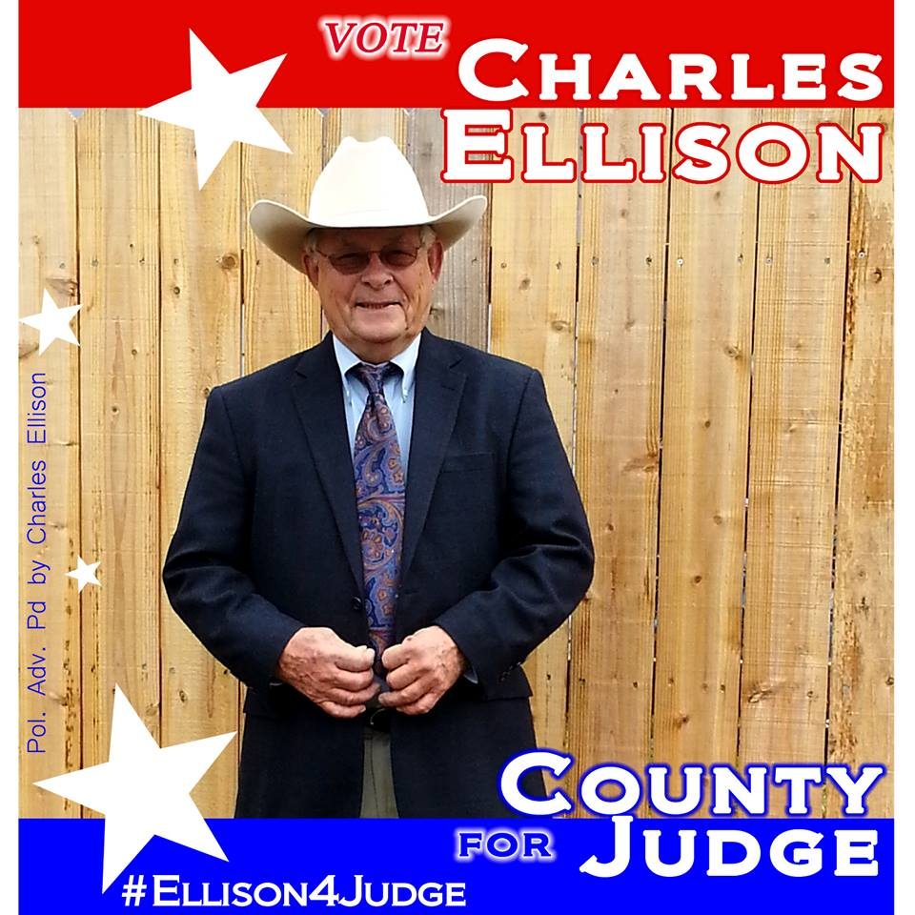

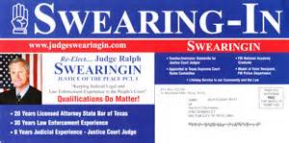
WHO THE CRC FUNDS
County Judge,
County Commissioner,
District Attorney,
Sheriff,
County Court at Law,
County Attorney,
Tax Assessor-Collector,
Justice of the Peace,
Constable,
and other miscellaneous partisan local elections.

Slide 7

WE ARE THE INCUBATOR
Many of our top elected officials started
out as lower ballot candidates and elected
officials.
Whether you are a Justice of the
Peace, a Constable, a County Judge….
This is the training ground for future
office.

Slide 8

TEXAS GOP INCUMBENTS
WE DEFEND THE GROUND WE HAVE ALREADY WON.
We support the lower ballot incumbents with funds and non-financial campaign assistance.
This keeps Texas RED

Slide 9
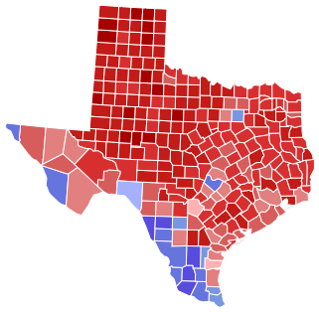
WE FIGHT FOR BATTLEGROUND SEATS
We provide financial and other types of assistance to GOP challengers against democrat incumbents in winnable districts.
This turns Texas REDDER.
Texas Map –Governors 2014 Election
By Gage (Own work) [Public domain], via Wikimedia Commons

Slide 10
WE WORK BEHIND ENEMY LINES
Live in a blue county? …. We are here to help.
We target blue counties to turn them red.
Planting seeds is critical in areas that historically vote democrat.

Slide 11
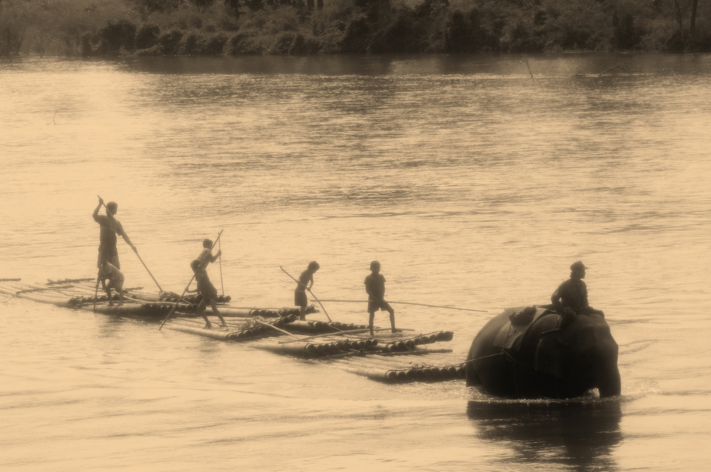
WE HELP FLOAT THE BOAT
FOR THE ENTIRE TICKET
Obviously under votes are hurting us in electing lower ballot candidates.
A focus on lower ballot races not only helps these candidates but middle ballot candidates like state representatives etc.
It increases the number of campaigners working voters.
It also increases the likely hood of a straight ticket vote.

Slide 12

WHERE WE GET THE MONEY?
Most of our money comes from you, the GRASSROOTS.
The CRC Fund gets its biggest boost from donations at the Republican
State Convention.
In addition, each SREC member is responsible for
raising or giving a minimum of $1000 to the fund each year.
A list of the SREC members that raised $1,000 or more can be found under the KEY PIN page.

Slide 13
WHERE DOES THE MONEY GO?
Historically, our primary donation targets are the small and medium population counties in Texas.
A $1,000 donation will go a lot farther in say Cass County or Limestone County as opposed to Harris or Dallas counties.
However, the battleground has shifted to larger metropolitan counties as well with the overall strategy set by the RPT.

Slide 14
HOW WE FUND CANDIDATES
Candidates applying for CRC funding submit an application found on the RPT website.
Each applicant must get his/her county chair and/or one of his/her SREC members to send in a separate, confidential referral form.
The candidates are then vetted by the CRC at its biannual distribution meeting according to rule 43a and other criteria.
The candidates are then vetted by the CRC at its biannual distribution meeting. .

Slide 15

The Democrats are doing it
They are targeting Red Counties
They are running candidates in local and lower ballot elections i.e. Incubator
They are providing financial support
They are providing other types of campaign support

Slide 16

Lets take the fight to them !!!
You can make a huge difference in defeating
Battleground Texas again.
Help us by making your donation to the
CRC – The Candidate Resource Committee of the
Republican Party of Texas.
$25 buys 5 signs
$100 buys 2000 push cards
$1000 buys 500 piece mailer
You can pay by check, cash, or credit card pay with
our CRC envelope or on-line
www.Texasgop.org/crc
CRC elephant logo by Sue Evenwel SREC SD 1

Slide 17

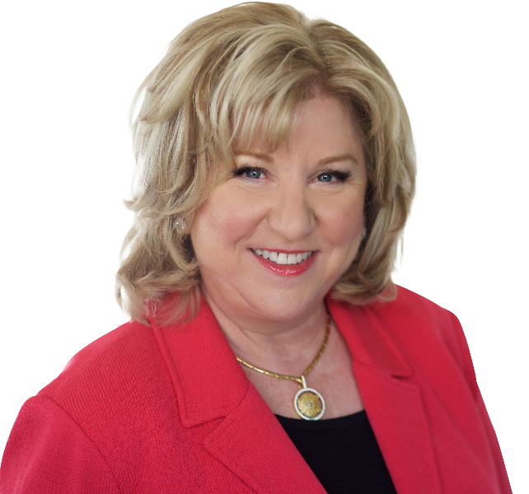
CANDIDATE RESOURCE COMMITTEE CAPITAL CLUB
Platinum Level Member
SENATOR JANE NELSON
SD 12
Senate Finance Committee Chairwoman
Longtime CRC Supporter

Slide 18
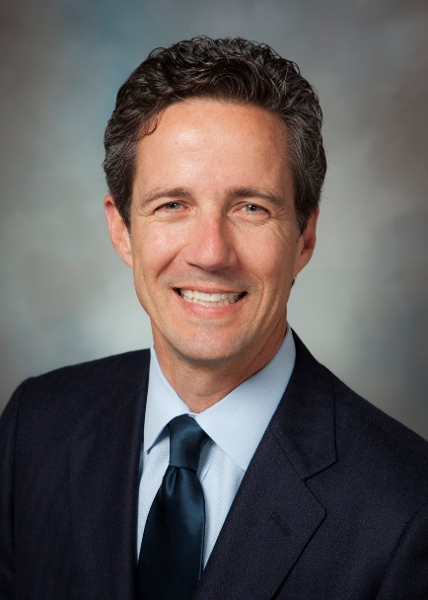
CANDIDATE RESOURCE COMMITTEE CAPITAL CLUB
Platinum Level Member
SENATOR Kelly Hancock
SD 9
Senate Administrative Chairman
Senator Business and Commerce Chairman

Slide 19

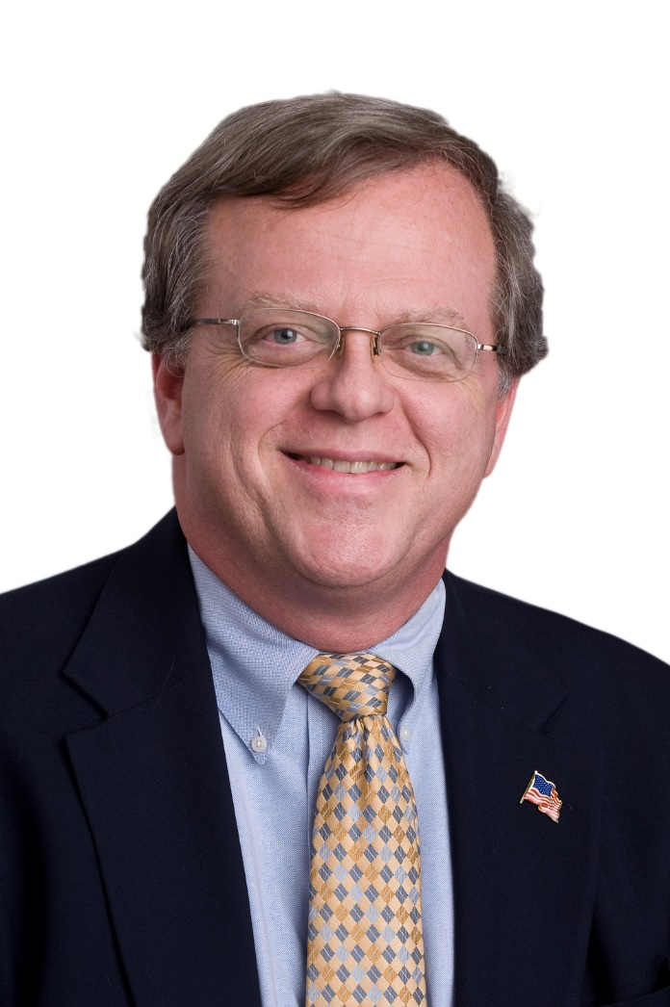
CANDIDATE RESOURCE COMMITTEE CAPITAL CLUB
Platinum Level Member
SENATOR
PAUL BETTENCOURT
SD 7
Senate GOP Caucus Chairman
Former CRC Committee member
Property Tax Reform Warrior

Slide 20
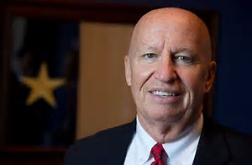
CANDIDATE RESOURCE COMMITTEE CAPITAL CLUB
Platinum Level Member
Congressman Kevin Brady
HD 8
Chairman of the House Ways and Means Committee
Thank you CRC Committee member Bob Borokoft

Slide 21
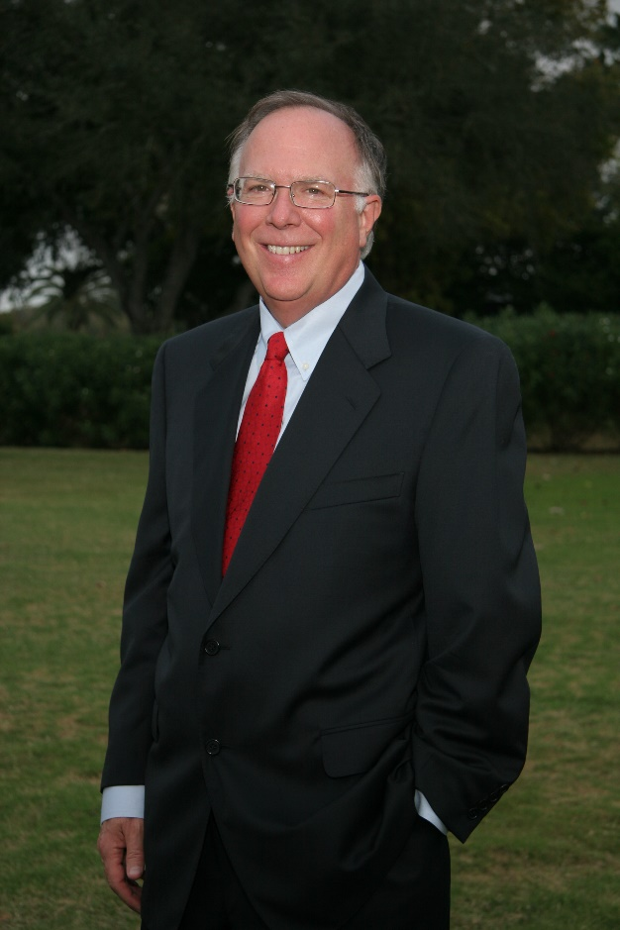
CANDIDATE RESOURCE COMMITTEE CAPITAL CLUB
Platinum Level Member
Rep. Todd Hunter
HD 8
Chairman of the Calendar Committee
Thank you CRC Committee member Janie Melendez

Slide 22
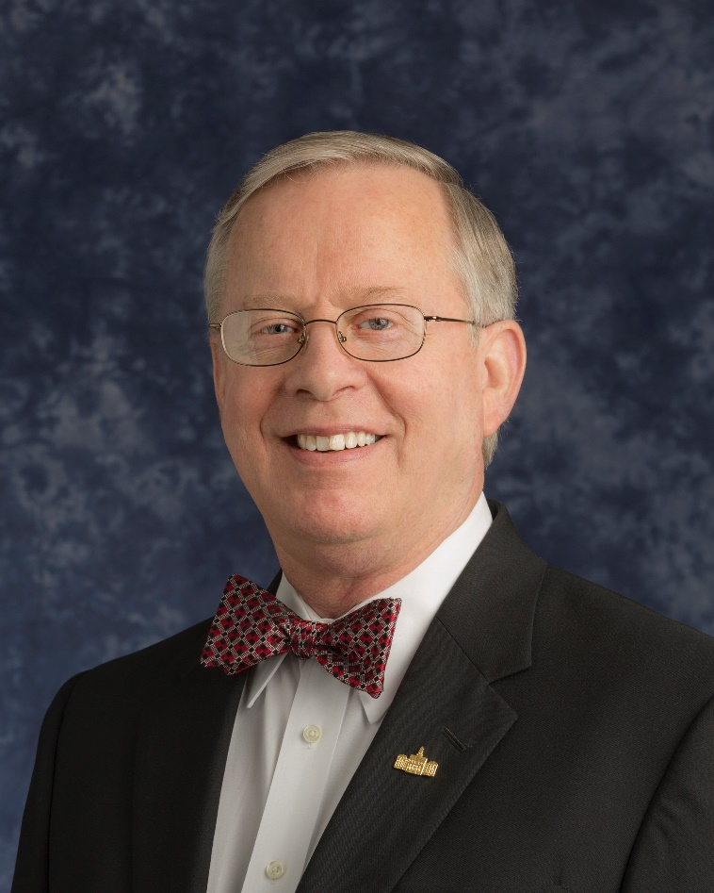
CANDIDATE RESOURCE COMMITTEE CAPITAL CLUB
Platinum Level Member
GOP CONGRESSIONAL NOMINEE HD 6
TARRANT CO TAX ASSESSOR-COLLECTOR
RON WRIGHT
Future Freedom Caucus Member
Former CRC FUND RECIPIENT

Slide 23
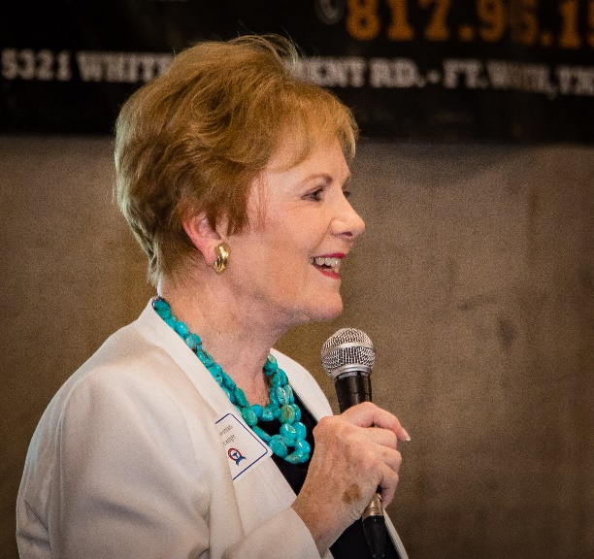
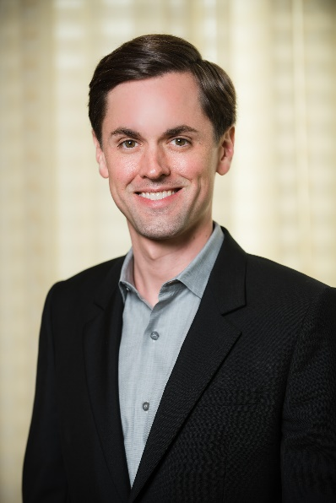
CANDIDATE RESOURCE COMMITTEE CAPITAL CLUB
Gold Level Members
Hon. Kay Granger
Congresswoman TX HD 12
Mayes Middleton
Republican Nominee in HD 23

Slide 24
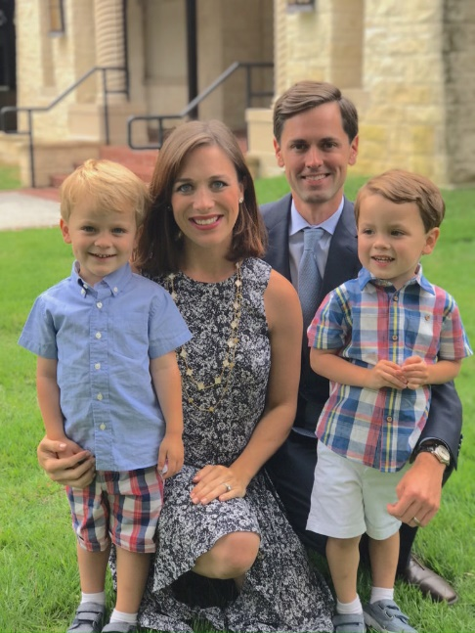
CANDIDATE RESOURCE COMMITTEE CAPITAL CLUB
Gold Level Member
Mayes Middleton

Slide 25

CANDIDATE RESOURCE COMMITTEE CAPITAL CLUB
Silver Level Members
State Representative Phil King HD 61
State Representative Jason Isaac HD 45
State Representative Gio Capriglione HD 98
Tarrant County Judge Glen Whitley
Former SREC SD 12 Mona Bailey
CRC Committee member Cindy Asche

Slide 26
CANDIDATE RESOURCE COMMITTEE CAPITAL CLUB
Bronze Level Member
Texas Ag. Commissioner Sid Miller
Texas Land Commissioner George P. Bush
Texas Railroad Commissioner Christi Craddick
Texas Railroad Commissioner Ryan Sitton
US Congressman CD 13 Mac Thornberry
US Congressman CD 26 Dr. Michael Burgess
US Congressman CD 25 Roger Williams
US Congressman CD 24 Kenny Marchant
State Senator SD 1 Brian Hughes

Slide 27
CANDIDATE RESOURCE COMMITTEE CAPITAL CLUB
Bronze Level Member
State Representative HD 96 Bill Zedler
State Representative HD 93 Matt Krause
State Representative HD 91 Stephanie Klick
State Representative HD 92 Jonathan Stickland
State Representative HD 96 Craig Goldman
State Representative HD 5 Cole Hefner
State Representative HD 68 Drew Springer
State Representative HD 11 Travis Clardy
Mayor Dalworthington Gardens Kimberly Fitzpatrick
Republican Party Chairman James Dickey
National Committeewoman Toni Anne Dashiell

Slide 28
CANDIDATE RESOURCE COMMITTEE CAPITAL CLUB
Bronze Level Member
SREC Sgt-at-arms Nelda Eppes
SREC Committeewoman Marian Stanko
State Rep Candidate & SREC Committeewoman Candy Nobel
SREC Committeewoman Melanie Flowers
Fmr. SREC Committeewoman Rena Peden
Nueces County Chair Mike Bergsma
Fmr SREC Parlimentarian Richard Hayes
Melody Gillett
Republican Club of Bexar Co
Bastrop County GOP

Slide 29

CANDIDATE RESOURCE COMMITTEE CAPITAL CLUB
Copper Level Member
Republican Women of Northeast Texas
Titus County Republican Party
Republican Women of Greater North Texas

Slide 30

CANDIDATE RESOURCE COMMITTEE
Thank you Committee!!!!!
SREC MEMBERS Non SREC MEMBERS
Steve Atwell SD 9 Chair Russell Hayter
Vergel Cruz SD 15 Vice Chair Fred Tate
Sue Evenwel SD 1 Mona Bailey
JT Edwards SD 11 Rena Peden
Kathaleen Wall SD 17 Harold Jenkins
Jan Duncan SD 14 Bob Borokoff
Deon Starnes SD 30 Option Members
Judy Parada SD 3 Lisa Hendrickson
Allison Winter SD 4 Jack Barcroft
Anne Gebhart SD 9 Jerry Madden
Tom Roller SD 31 James Beauchamp
Marian Stanko SD 26 Chair James Dickey
Vice Chair Alma Jackson

